Slide 1


ECEN 403 Demo
Luggage Carrier and Tracker Team 1 Aiden Shepard
TA: Vishwam Raval
Professor: Stavros Kalafatis

Slide 2
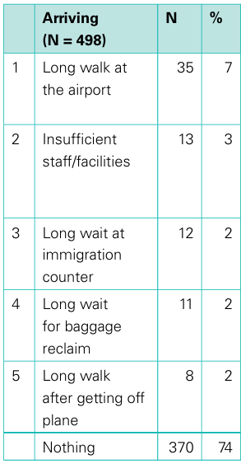
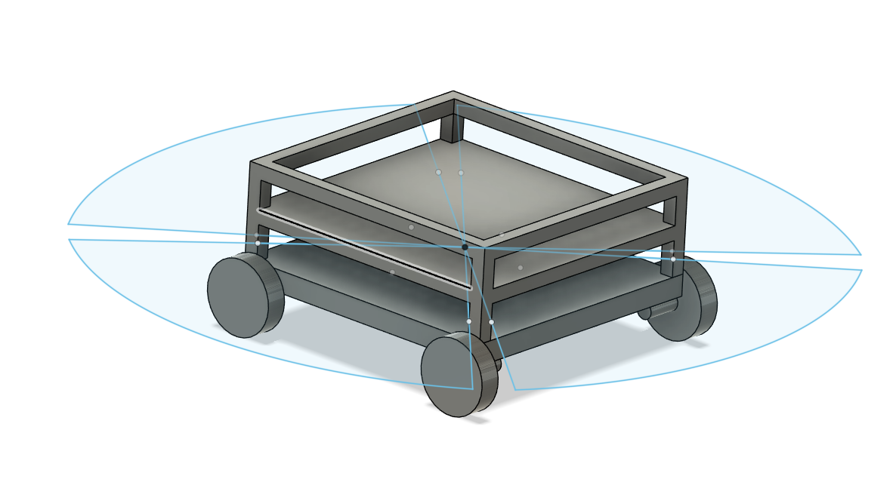
Project Summary
Problem Statement:
In large airports, people with large, unconventional luggage face difficulties carrying it
No affordable, autonomous solution exists
Our Solution:
Autonomous luggage rover that follows the user, avoids obstacles, and carries at least 20 lbs
Tracks user for navigation
Figure1: Passenger complaints at Heathrow Airport
CAA Passenger Survey Report 2018 (Heathrow / Gatwick / Stansted), UK Civil Aviation Authority, 2019.

Slide 3
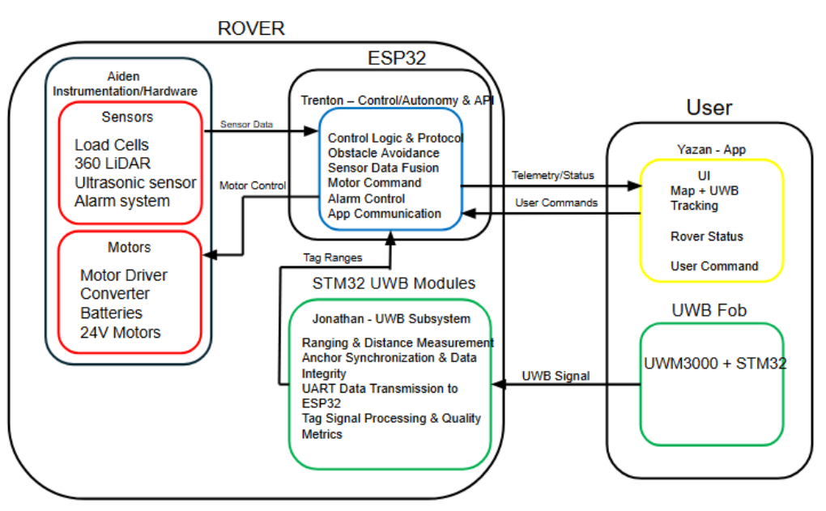
Notes:
Cloud server and database

Slide 4
Engineering Design Accomplishments
Power and Instrumentation - Aiden Shepard
Instrumentation & Power One-Line
ESP32
.05 A
12 A
ESP32
Sabertooth Motor Driver
4x DC Motors
12.3A
.1 A
Batteries
24V
Load Cells
.05 A
Buck Converter PCB
.65A
Ultrasonic Sensors
5V
.5 A
.256A
3.3V
360 LiDAR
.63A
.1 A
Ultra-Wideband
.03 A
Alarm System
.5A
403 Accomplishments
Buck Converter (24 V to 5 V & 3.3 V) designed, assembled, and tested
Completed motor driver logic and power troubleshooting and verified logic inputs
Instrumentation/sensor suite selected and designed for obstacle, tracking, and weight detection
Instrumentation power draw testing

Slide 5
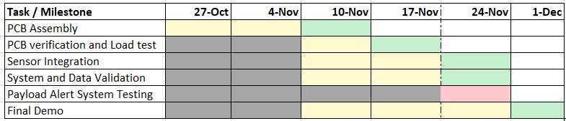
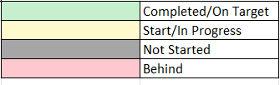
Execution plan
‹#›

Slide 6
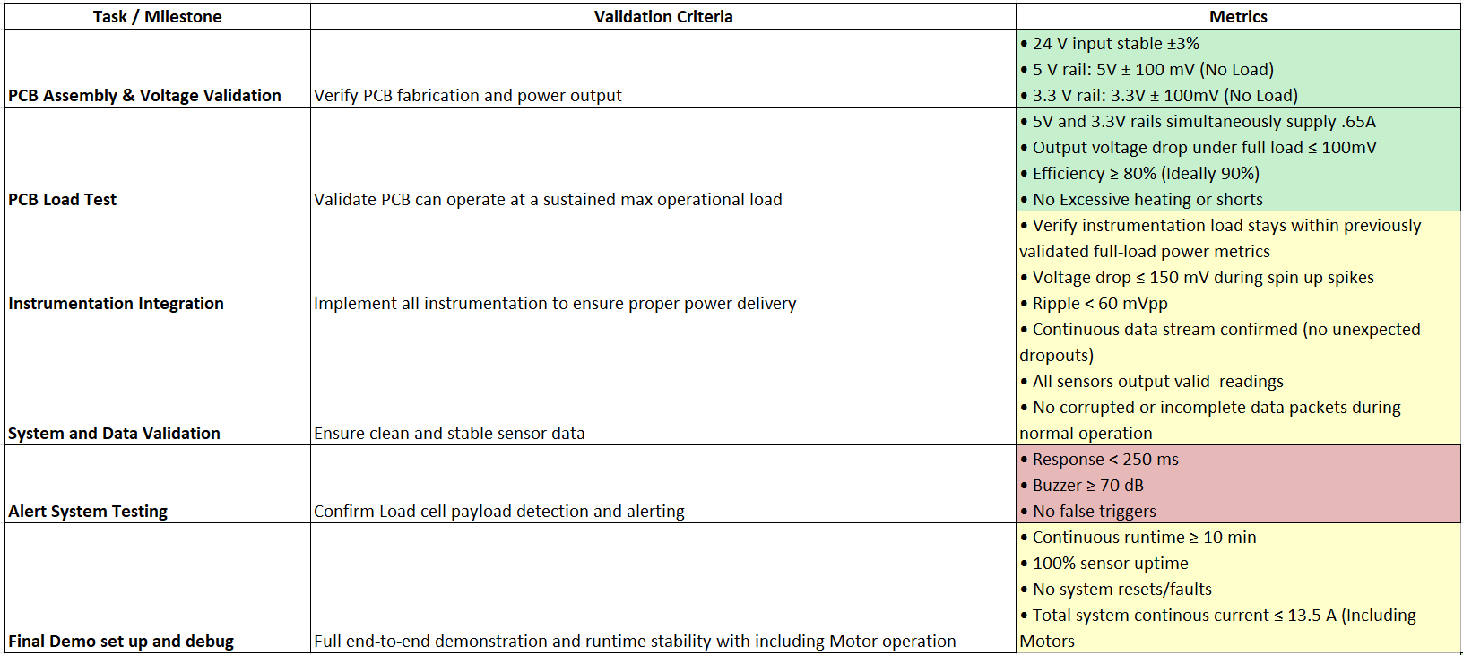

Validation plan
‹#›

Slide 7
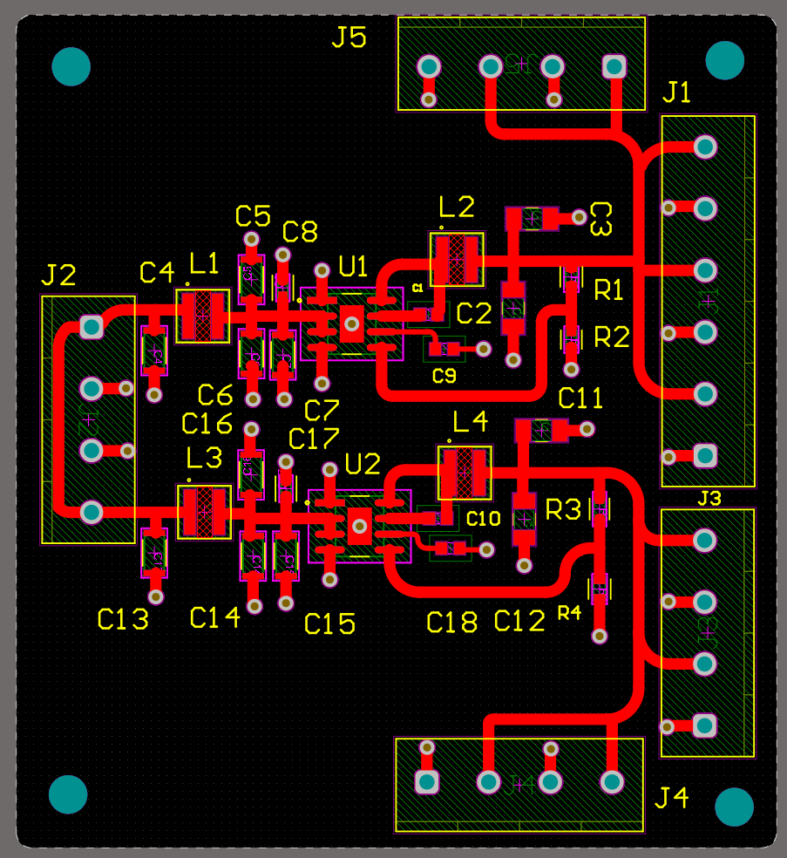
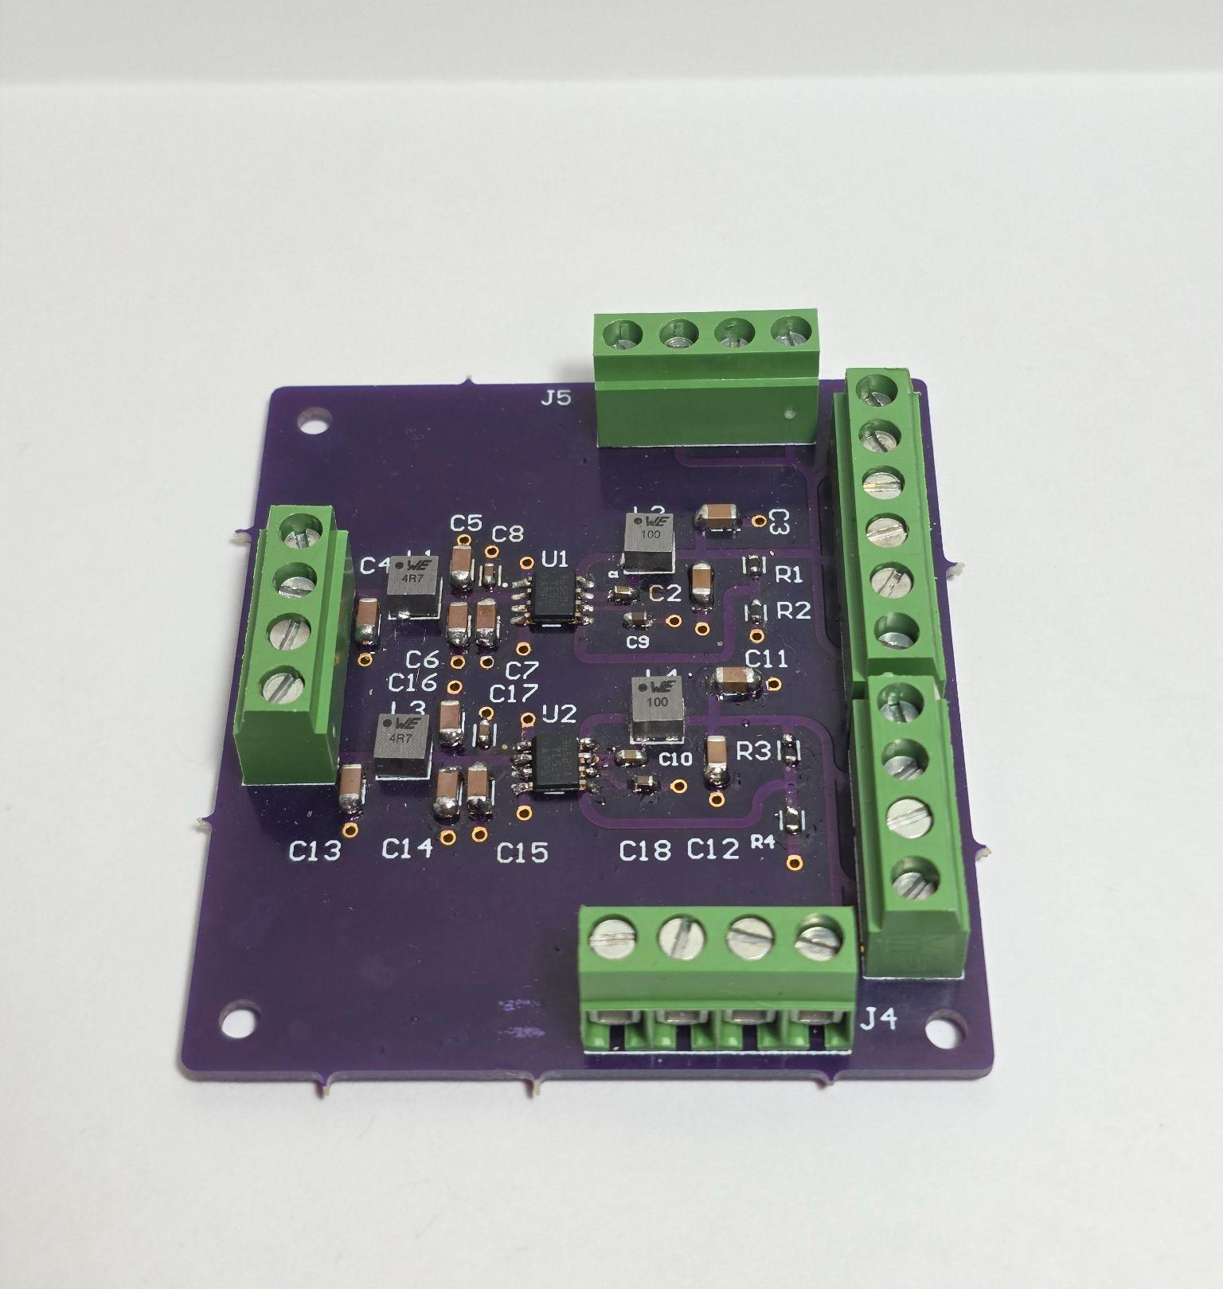

Engineering Design Accomplishments
Buck Converter Design

Slide 8
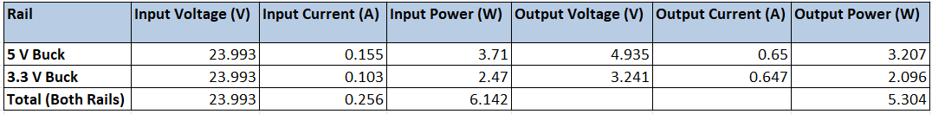
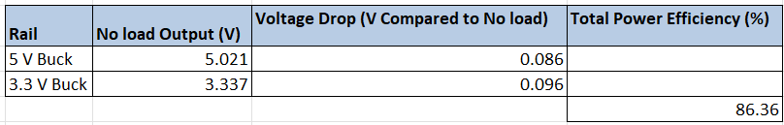
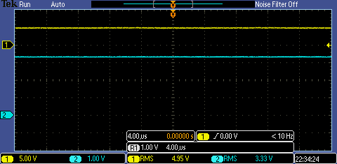
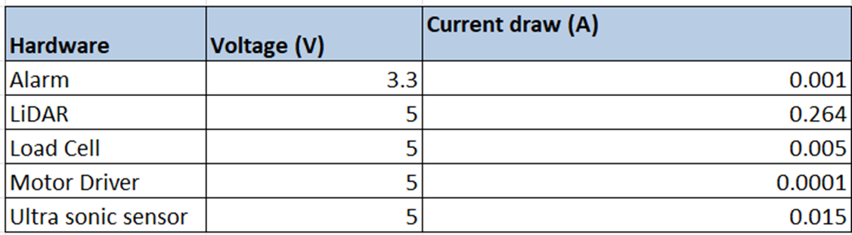
Engineering Design Accomplishments
Buck Converter Load Testing

Slide 9
Remaining 404 Tasks
Mechanical & Payload Integration
Finalize and install payload structure with calibrated load cells
Integrate mechanical mounting for electronics bay, sensors, and batteries
Electronics Bay & Sensor Suite Integration
Implement electronics bay for buck converter, LiDAR, ultrasonic, alarm module, and UWB
Validate clean, stable sensor data under full-system operation
Control & Autonomy Subsystem Collaboration
Verify Sensor functionality
Implement motor driver logic and motor functionality
Conduct end-to-end functional testing of tracking, payload, and obstacle detection

